Slide 1
Dawlish Christian Fellowship
To
Dawlish Christian Fellowship
at St Agatha’s Church
more people, more like Jesus

Slide 2
It would be great to connect with you!
Please fill in a connect card

Slide 3
Todays service is on

Slide 5
Can be found in the church hall
behind the church
Please ask the stewards & they will happily direct you in the right direction

Slide 6
In case of an emergency please leave the building calmly from the nearest fire exit to you. The fire exits are located at the front of the church & through the main entrance at the back.

Slide 7
The First Aiders on duty today are
Angela Rudall & Jo Jones

Slide 8
Anchor is for young people aged 11+ they meet during the service, in the side room at the front of the church.
Junior Church is for ages 4-11 year olds. They meet in the church hall during the service.

Slide 9
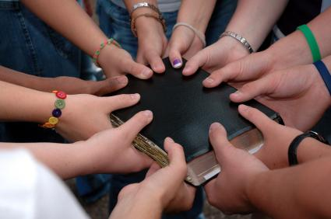
Praying Together
Monday 9am @ Black Swan Unit, Church Office
Thursday 11:30-12:30 @
The Strand Centre Lounge
PRAYING TOGETHER

Slide 11
Church Directory 2019
Please could you fill in a form & return it to Kim or Clive to have your name & details put in the church directory.
Without the form we will be unable to include you in this. Thank you

Slide 12
From the DCF Website

Slide 13
Reminder Please No food or drinks inside the church.
Thank You

Slide 15
This is an opportunity for all Youth & Children’s
leaders, Helpers & Mentors to attend on
Saturday 30th March from 10am-3pm. At South Street
Baptist Church Exeter.

Slide 16
When Faith And Crisis Meet Seminar - Wednesday 24th April. 7:00pm for 7.30pm, at Beacon Heath Church, Exeter.
An evening seminar with Nathan Jones, of TalkThrough ministry, exploring the subject of faith, the church and mental health in young people.
For more information please pick up a flyer from the notice board

Slide 17
Church weekend away to Heatree
The young people will soon be coming around asking for the full payment, this can be done by two ways through bank transfer or cash.

